Slide 1
Sprint 1 demo – CCP Tour app
Gerardo Flores, Ahram Kim

Slide 2
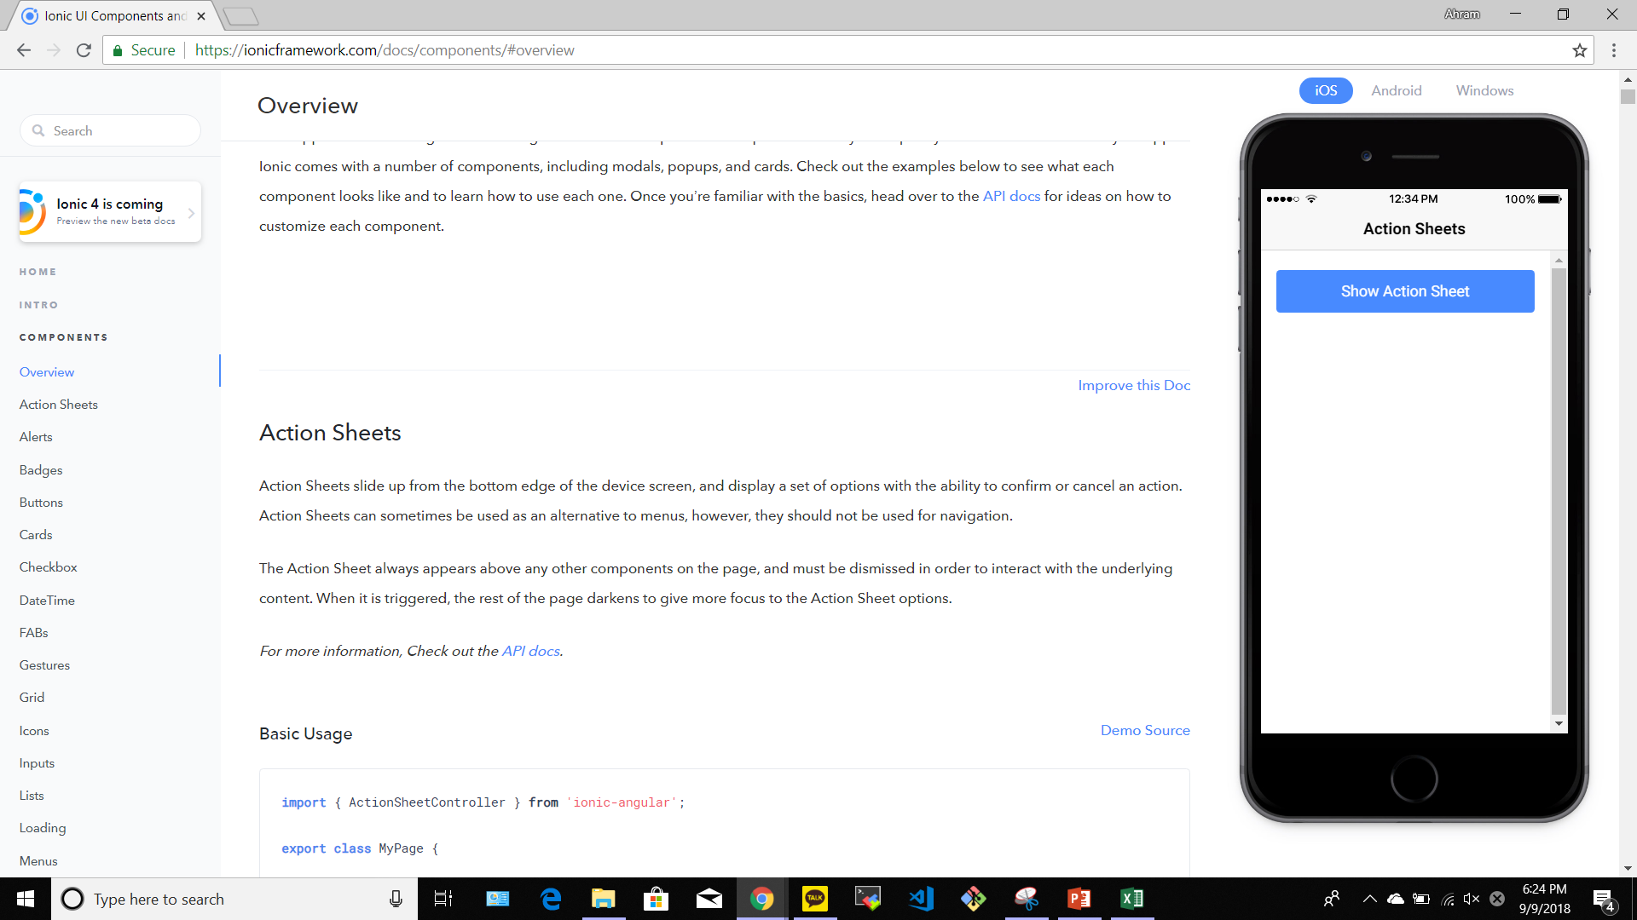
IONIC framework
Notes:
For this project, we are using the Ionic which is an HTML5 mobile app development framework targeted at building hybrid mobile apps. Ionic is a complete open-source SDK for hybrid mobile app development. With Ionic, we wanted to build an HTML5 mobile development framework that was focused on native or hybrid apps instead of mobile websites. Unlike a responsive framework, Ionic comes with very native-styled mobile UI elements and layouts that you’d get with a native SDK on iOS or Android but didn’t really exist before on the web.
We have and understand of what Ionic is and why it exists, we were ready to start building our CCP Tour app with Ionic.
When building hybrid apps with Ionic, the bulk of an Ionic app will be written in HTML, JavaScript, and CSS. Those familiar with web development will find the structure of an Ionic app straightforward. The only difference is, instead of creating a website that others will link to, we are building a self-contained application experience. Ionic also uses AngularJS for a lot of the core functionality of the framework.

Slide 3
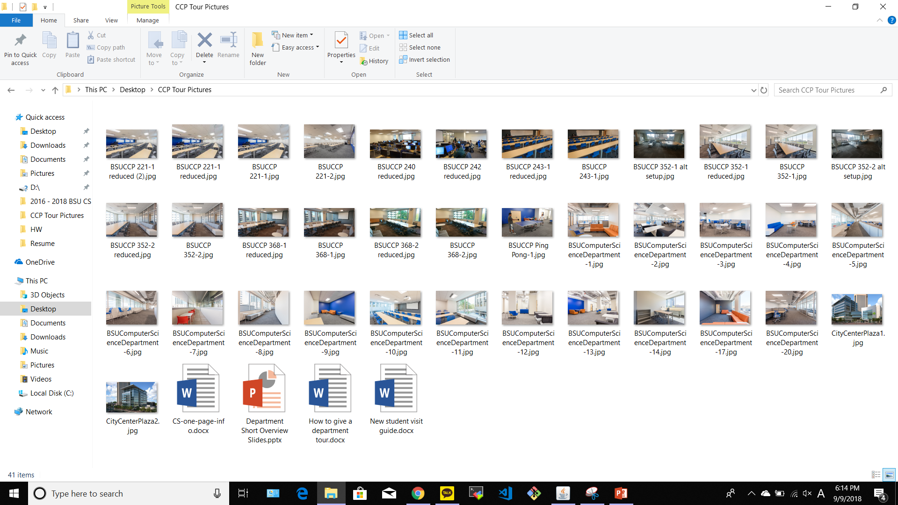
Collect DATA
Notes:
We collect all contents and information which are needed when we make the app about CCP Tour. There are lots of pictures such as classroom, professors’ office, place to play ping pong, place to study, and place to have lunch.
It includes the information about degrees offered from cs department, department figures, map of tour route for the department, and guide for new student visit.

Slide 4
Definition of done
All acceptance criteria have been met
Ionic, HTML, CSS, JS
Collected data from Ashley
We have tested to connect to Ionic framework and not found any defects
Build pushed to demo server

Slide 5
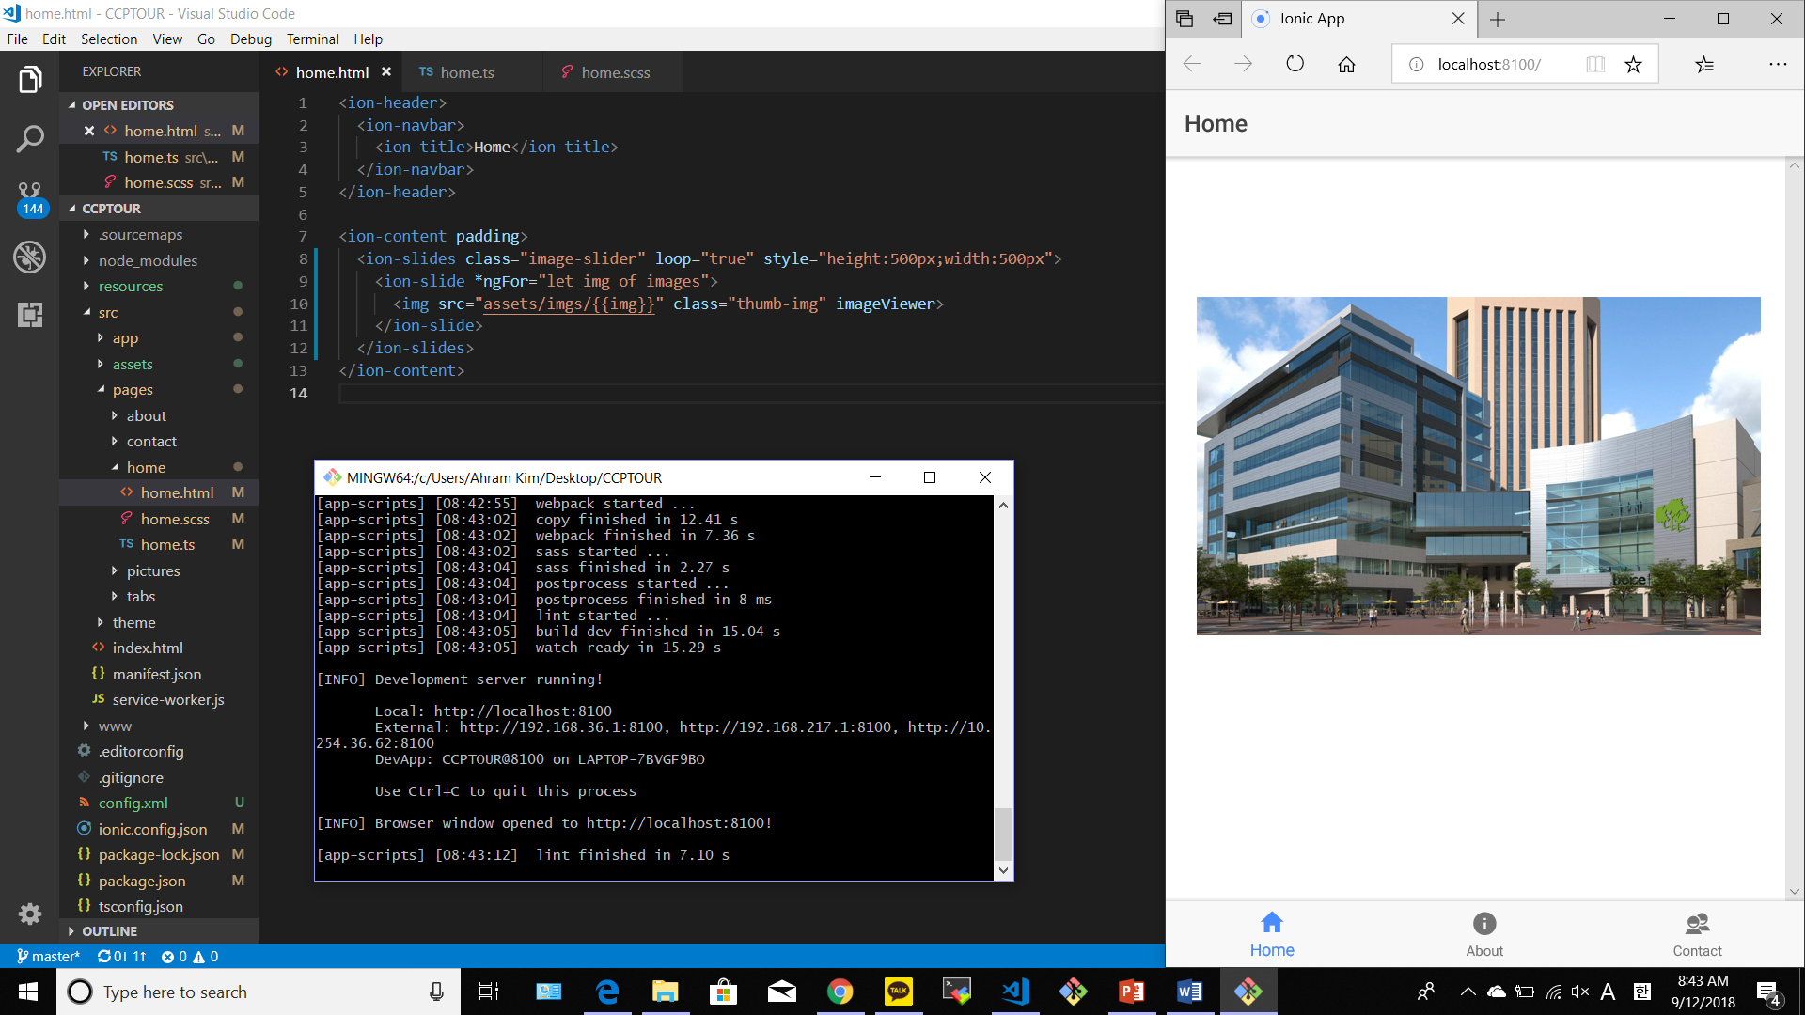

Slide 6
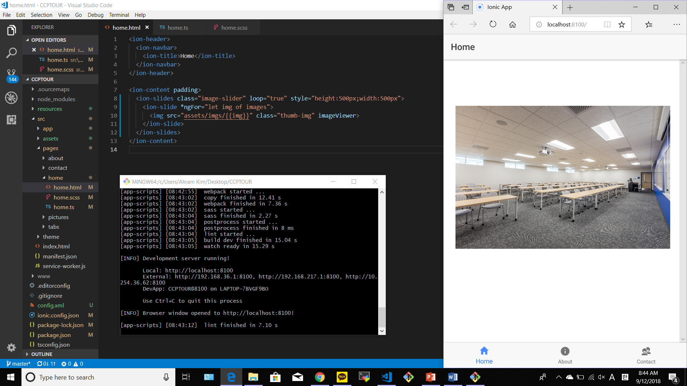

Slide 7
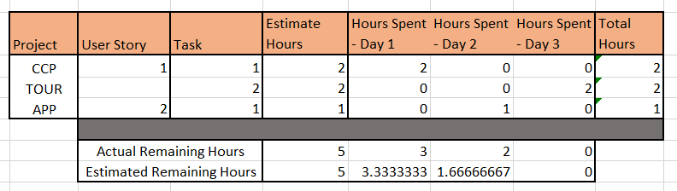
BURNDOWN CHART

Slide 8
Burndown chart

